Slide 1
Sleep Efficiency Analysis
Team 04
Cohort D
Hemanth Sindhanuru
Praneeth Varma
Sining Zhu
Manali Teli

Slide 2
Introduction
Importance of sleep and it’s effect on health.
Fitness trackers help quantify sleep and analyze sleep habits
Factors that influence the quality of sleep.
Our aim is analyzing the affect of these factors on sleep efficiency

Slide 3
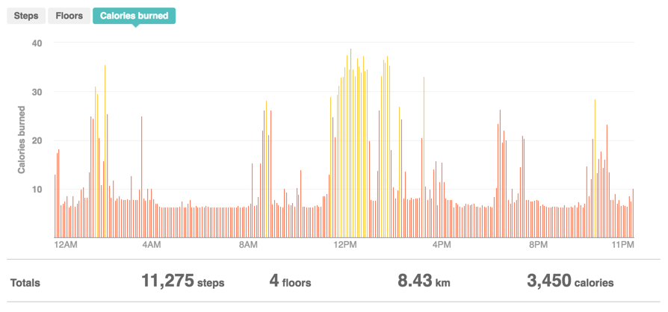
Experiment Overview
FITBIT Charge HR
Tracking sleep efficiency
Effects of factors on sleep

Slide 4
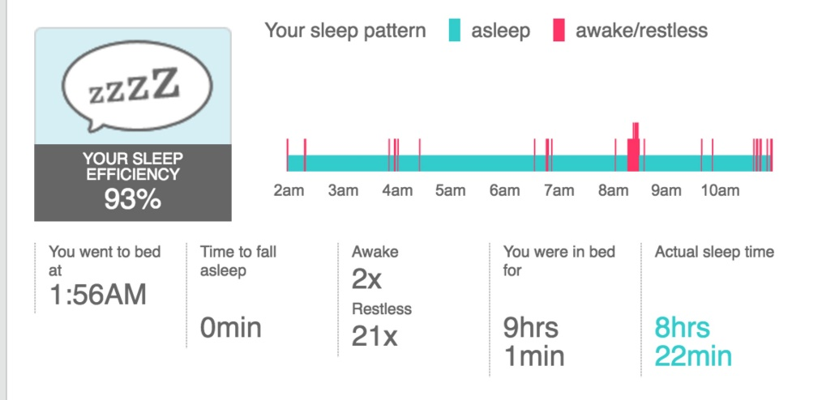
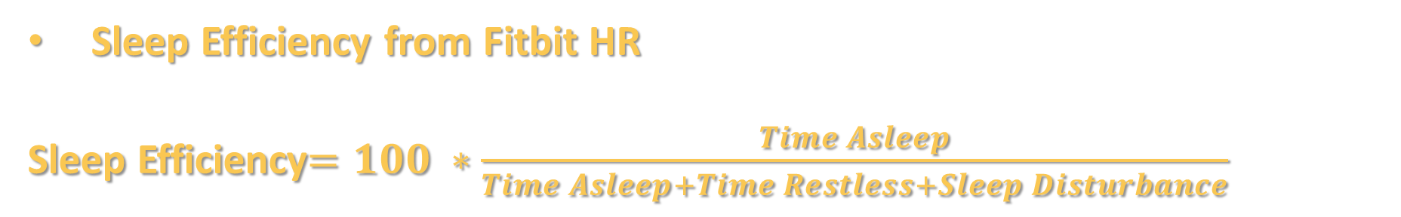
Response Variable
Sleep Efficiency from Fitbit HR
Sleep Efficiency$=100 ∗\frac{Time Asleep}{Time Asleep+Time Restless+Sleep Disturbance}$

Slide 5
Factors
01
02
03
Caffeine intake
Calories Burnt
Time Gap between sleep
High: >75mg
Low: <10mg
High: >3000 Kcal
Low: <2400 Kcal
High: >18 hours
Low: <14 hours

Slide 6
Nuisance Variables
Operators – Blocking
Room Temperature – Held constant
Psychological state – Incontrollable

Slide 7
Experiment Design
1 Response variable
3 Factors, 2 Levels each
2³ Factorial design
2 Blocks – Operators
2 Replicates

Slide 8
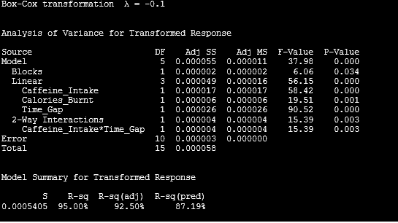
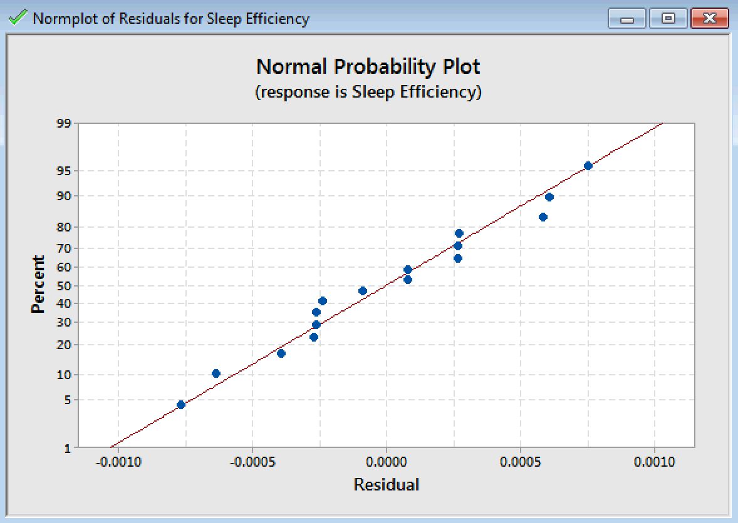
Statistical Analysis
Regression Equation in Uncoded Units
-Sleep Efficiency^-0.1 = -0.635329 - 0.001033 Caffeine_Intake + 0.000597 Calories_Burnt
+ 0.001286 Time_Gap + 0.000530 Caffeine_Intake*Time_Gap

Slide 9
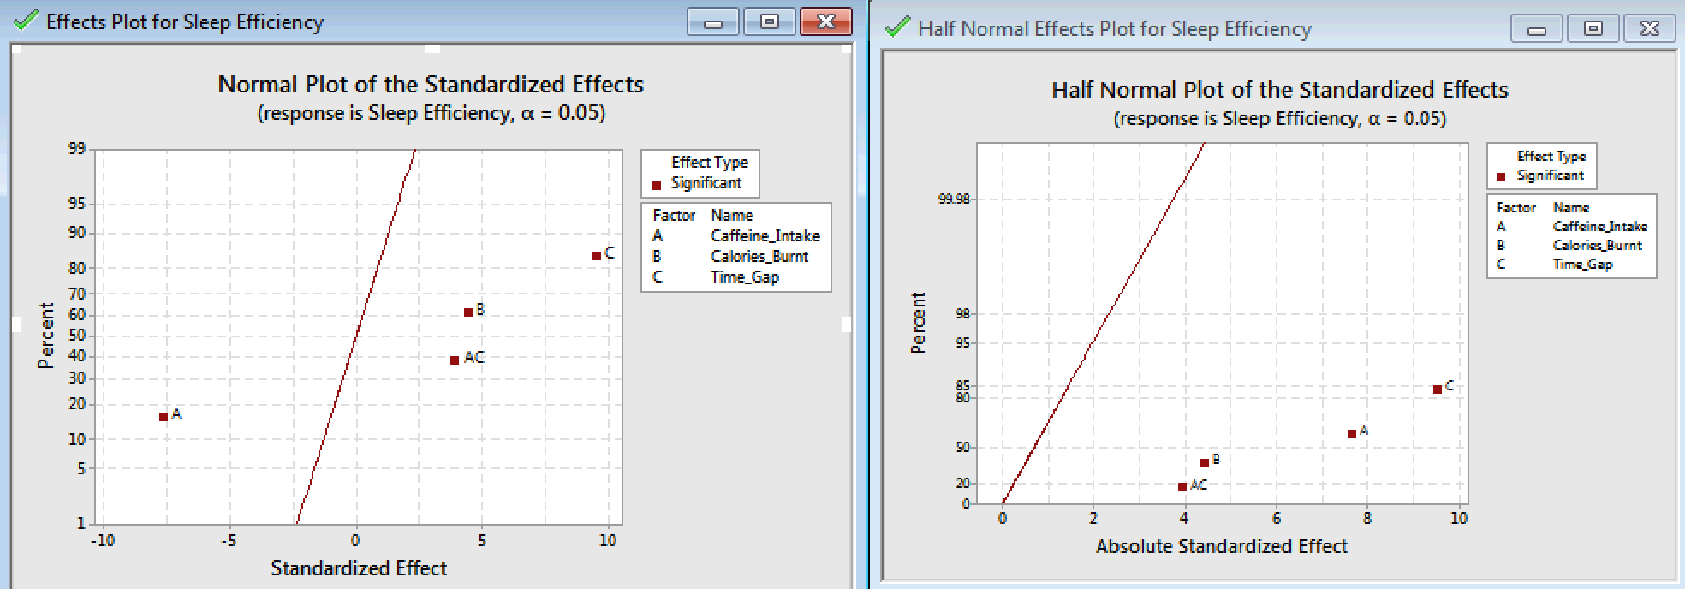
Statistical Analysis
Normal and half-Normal Probability Plots

Slide 10
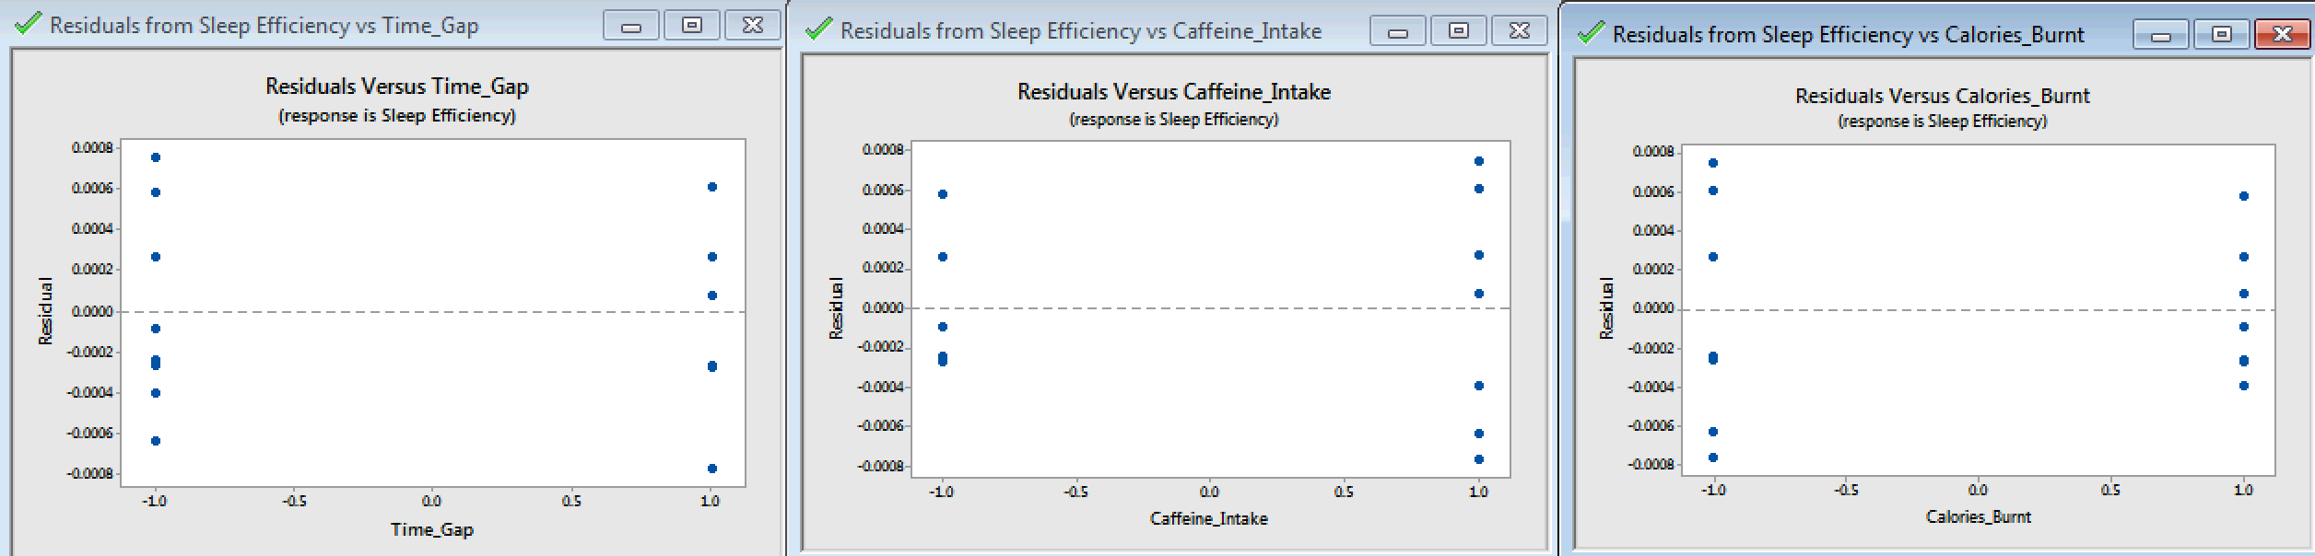
Statistical Analysis
Residuals versus Factors

Slide 11
Conclusion
Caffeine has a negative impact on Sleep Efficiency
Time Gap and Calories burnt has a positive impact on Sleep Efficiency
Interaction between Time_Gap and Caffeine_Intake has positive effect on Sleep Efficiency

Slide 12
Recommendations
Nullifying
uncontrollable
factors
Increasing
number of
operators
Increasing
number of
replicates

Slide 13
Thank you

